Slide 1
Normal Forms for
Context-free Grammars

Slide 2


Chomsky Normal Form
All productions have form:
and
variable
variable
terminal

Slide 3
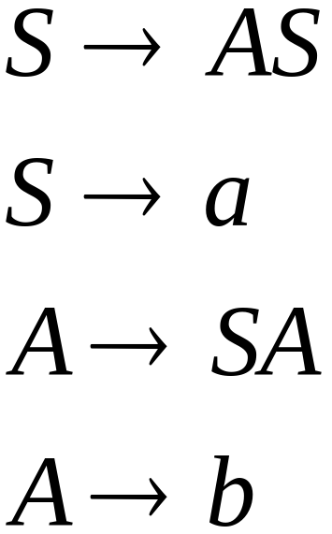
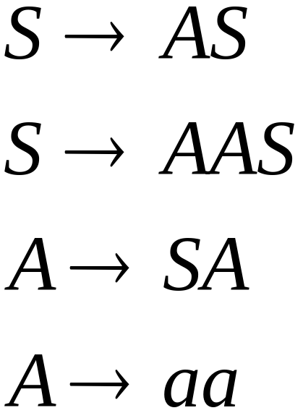
Examples:
Chomsky
Normal Form
Not Chomsky
Normal Form

Slide 4
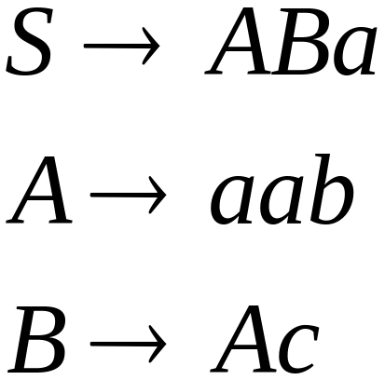
Convertion to Chomsky Normal Form
Example:
Not Chomsky
Normal Form

Slide 5
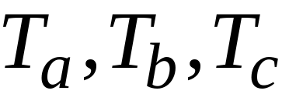
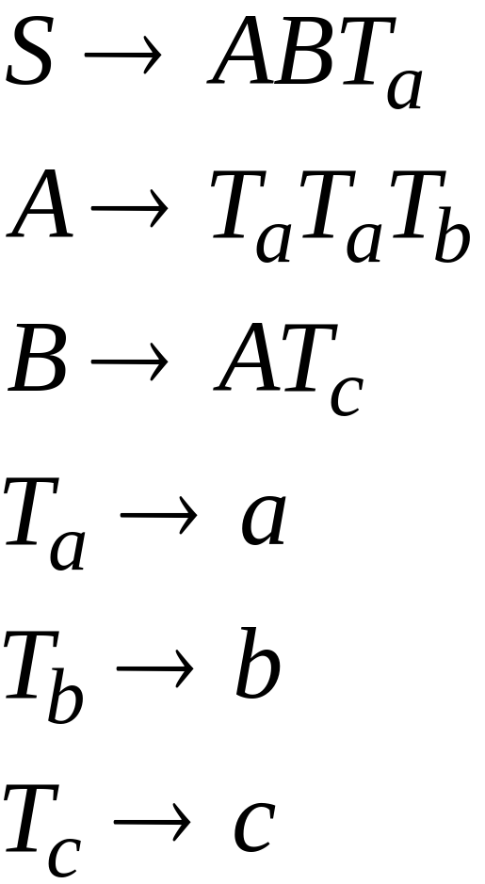
Introduce variables for terminals:

Slide 6

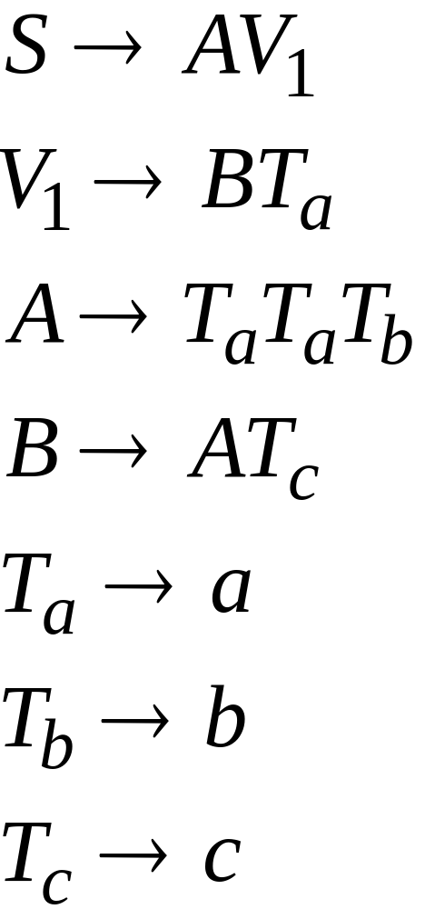
Introduce intermediate variable:

Slide 7
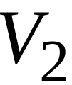
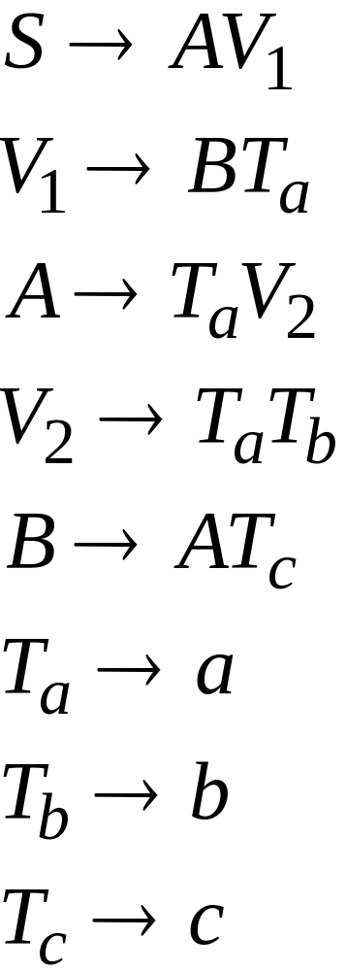
Introduce intermediate variable:

Slide 8
Final grammar in Chomsky Normal Form:
Initial grammar

Slide 9
In general:
From any context-free grammar
not in Chomsky Normal Form
we can obtain:
An equivalent grammar
in Chomsky Normal Form

Slide 10
The Procedure
First remove:
    Nullable variables
    Unit productions

Slide 11

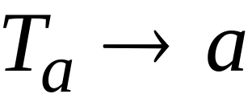

For every symbol :
Add production
In productions: replace with
New variable:

Slide 12
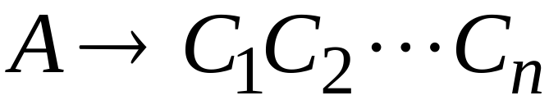
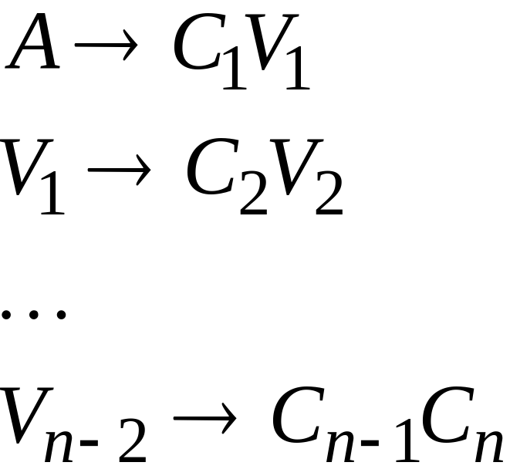
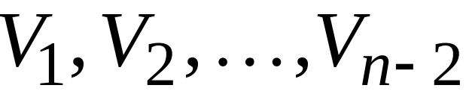
Replace any production
with
New intermediate variables:

Slide 13
Theorem:
For any context-free grammar
there is an equivalent grammar
in Chomsky Normal Form

Slide 14
Observations
Chomsky normal forms are good
for parsing and proving theorems
It is very easy to find the Chomsky normal
form of any context-free grammar

Slide 15
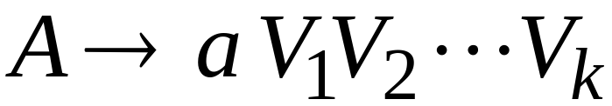

Greinbach Normal Form
All productions have form:
symbol
variables

Slide 16
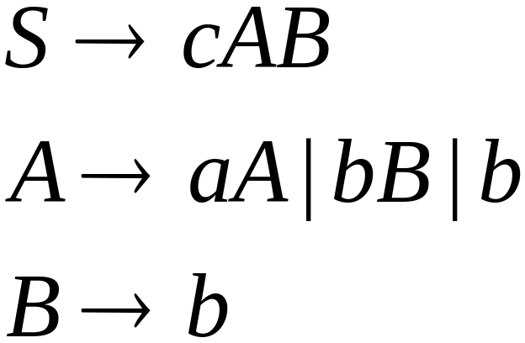
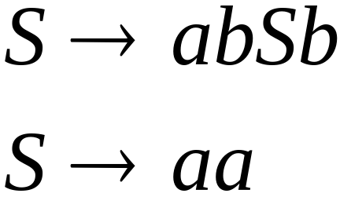
Examples:
Greinbach
Normal Form
Not Greinbach
Normal Form

Slide 17
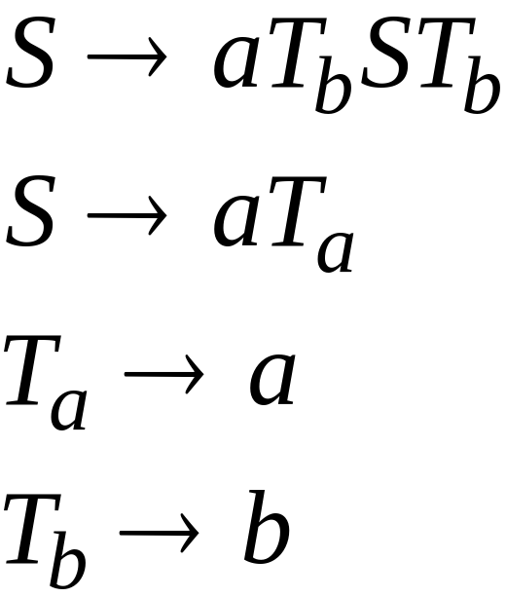
Conversion to Greinbach Normal Form:
Greinbach
Normal Form

Slide 18
Theorem:
For any context-free grammar
there is an equivalent grammar
in Greinbach Normal Form

Slide 19
Observations
Greinbach normal forms are very good
for parsing
It is hard to find the Greinbach normal
form of any context-free grammar

Slide 20
An Application
of
Chomsky Normal Forms

Slide 21



The CYK Membership Algorithm
Input:
Grammar in Chomsky Normal Form
String
Output:
find if

Slide 22
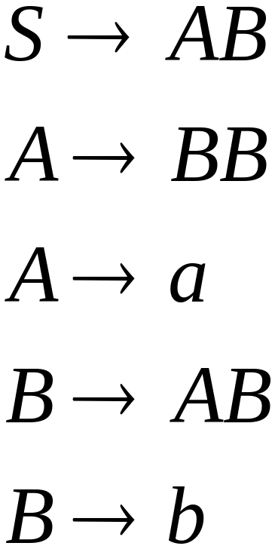

The Algorithm
Input example:
Grammar :
String :

Slide 23
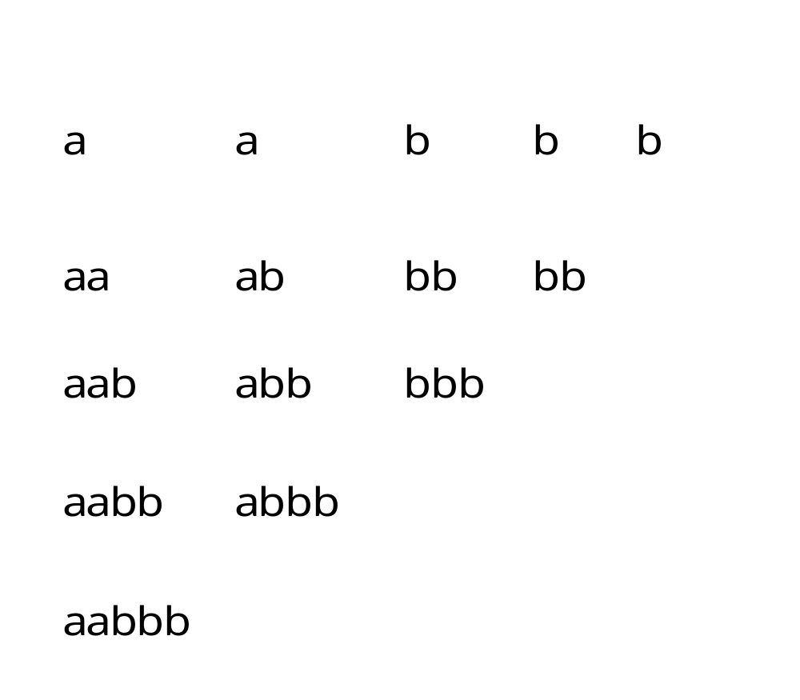

Slide 24
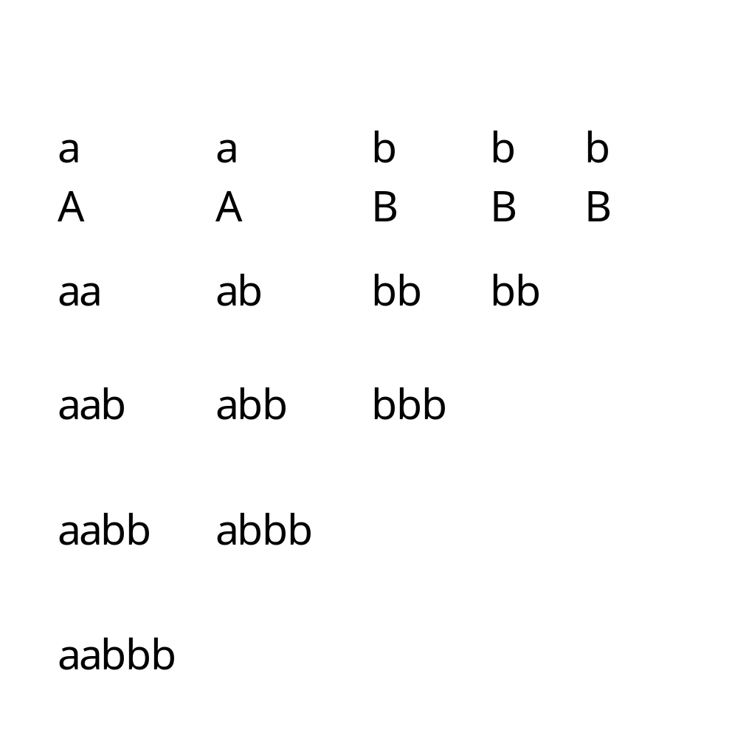

Slide 25
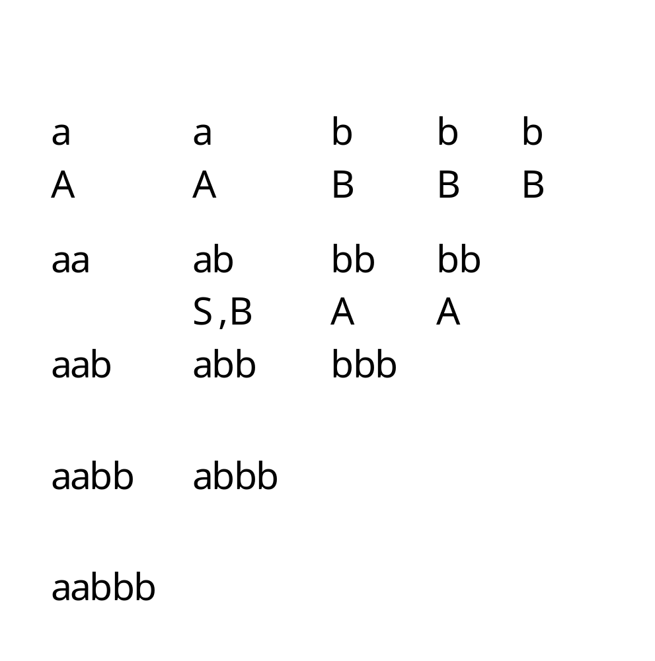

Slide 26
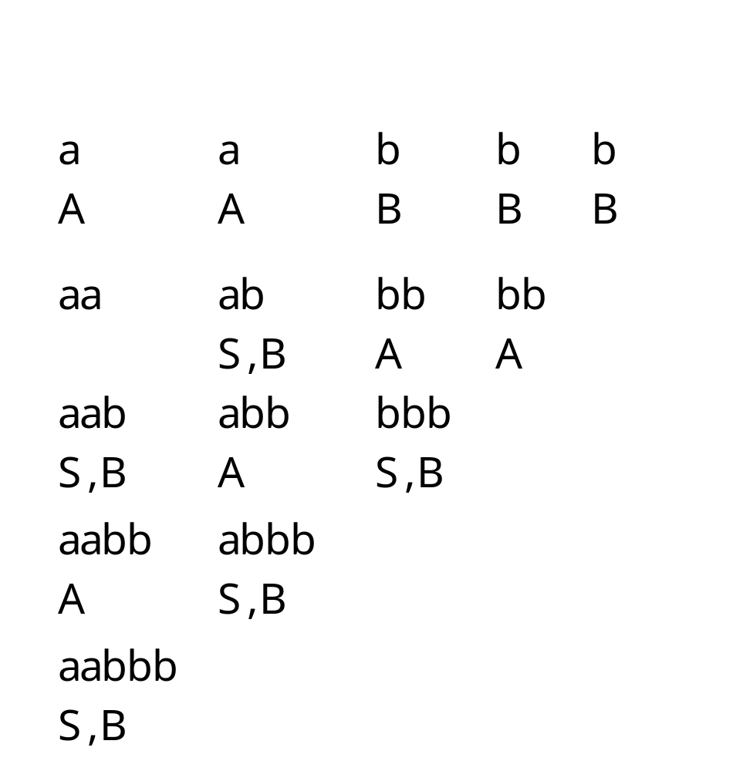
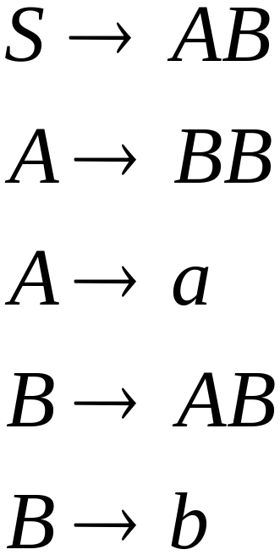

Slide 27
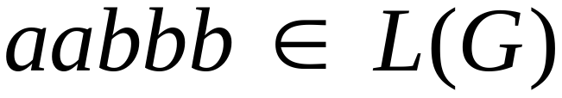
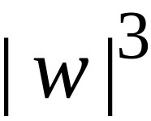
Therefore:
Time Complexity:
Observation:
The CYK algorithm can be
easily converted to a parser

Slide 28
Pushdown Automata
PDAs

Slide 29
Pushdown Automaton -- PDA
Input String
Stack
States

Slide 30


Initial Stack Symbol
Stack
Stack
bottom
special symbol

Slide 31



The States
Input
symbol
Pop
symbol
Push
symbol

Slide 32






input
stack
top
Replace

Slide 33

input
stack
top
Push

Slide 34

input
stack
top
Pop

Slide 35


input
stack
top
No Change

Slide 36



Non-Determinism

Slide 37





NPDA: Non-Deterministic PDA
Example:

Slide 38

Execution Example:
Time 0
Input
Stack
current
state

Slide 39
Time 1
Input
Stack

Slide 40
Time 2
Input
Stack

Slide 41
Time 3
Input
Stack

Slide 42
Time 4
Input
Stack

Slide 43
Time 5
Input
Stack

Slide 44
Time 6
Input
Stack

Slide 45
Time 7
Input
Stack

Slide 46
Time 8
Input
Stack
accept

Slide 47
A string is accepted if:
All the input is consumed
The last state is a final state
We do not care about the stack contents

Slide 48

The input string
is accepted by the NPDA:

Slide 49

In general,
is the language accepted by the NPDA:

Slide 50

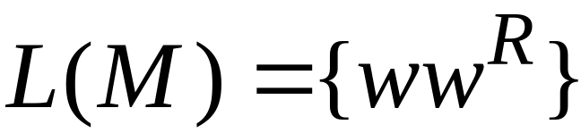
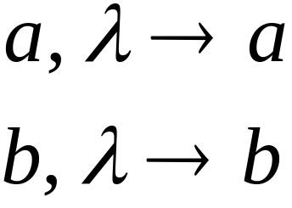
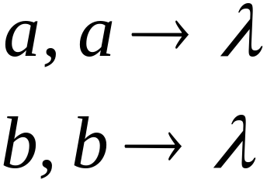
Another NPDA example
NPDA

Slide 51
Execution Example:
Time 0
Input
Stack

Slide 52
Time 1
Input
Stack

Slide 53
Time 2
Input
Stack

Slide 54
Time 3
Input
Stack

Slide 55
Time 4
Input
Stack

Slide 56

Time 5
Input
Stack

Slide 57
Time 6
Input
Stack
accept

